Slide 1
HUBcheck: Check the hub Master's Final Examination April 3, 2014 Derrick Kearney Purdue University
Notes:
Hello, my name is Derrick Kearney.
Welcome to the Final Examination for my Master's Degree.
I work for hubzero.org at Purdue University

Slide 2
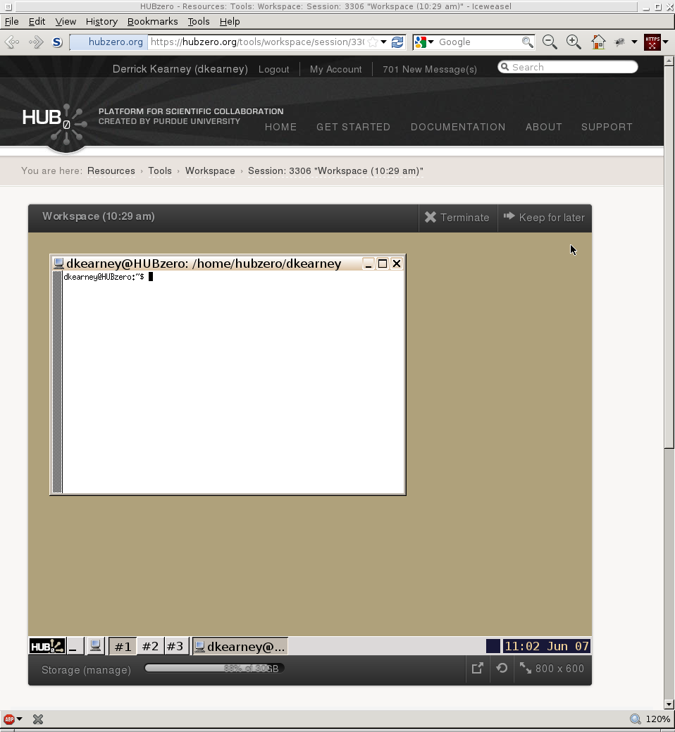
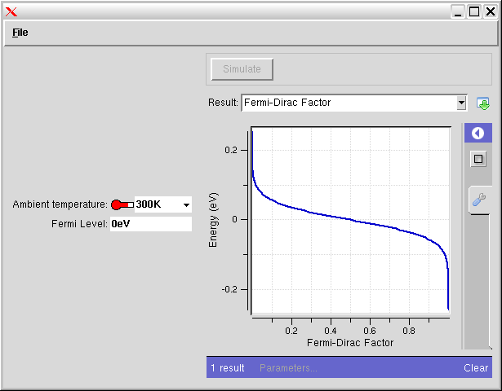


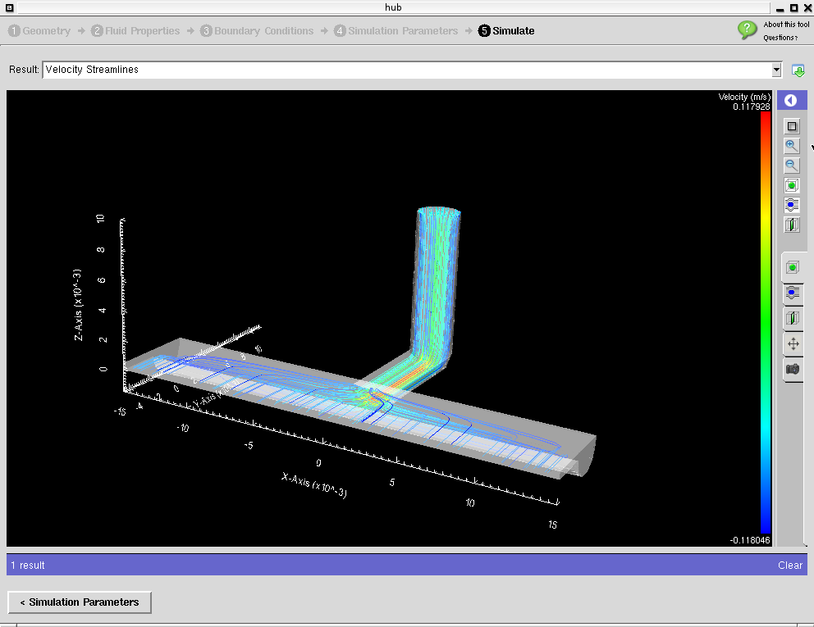
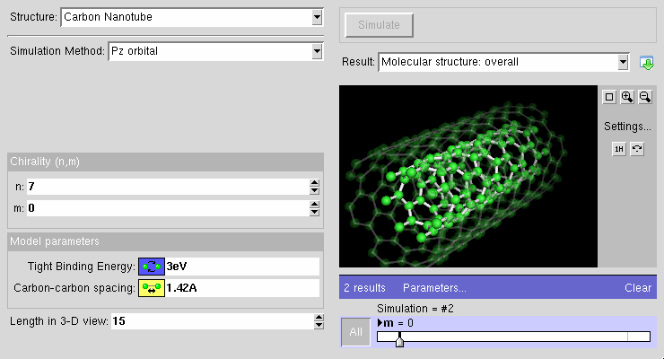
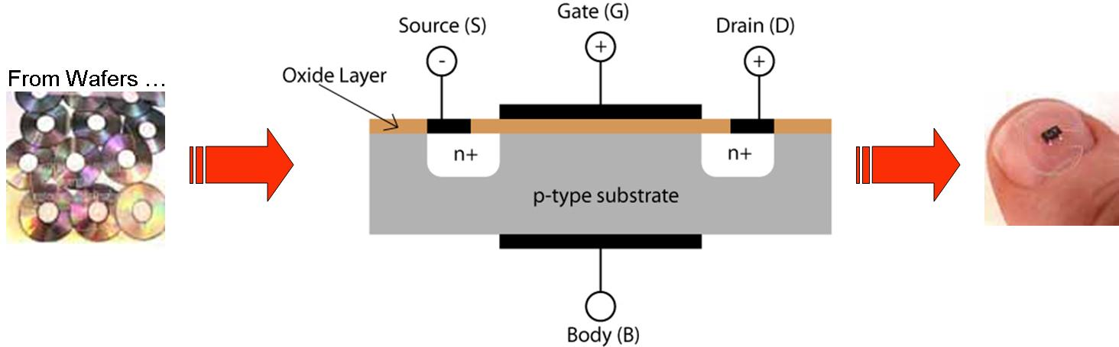

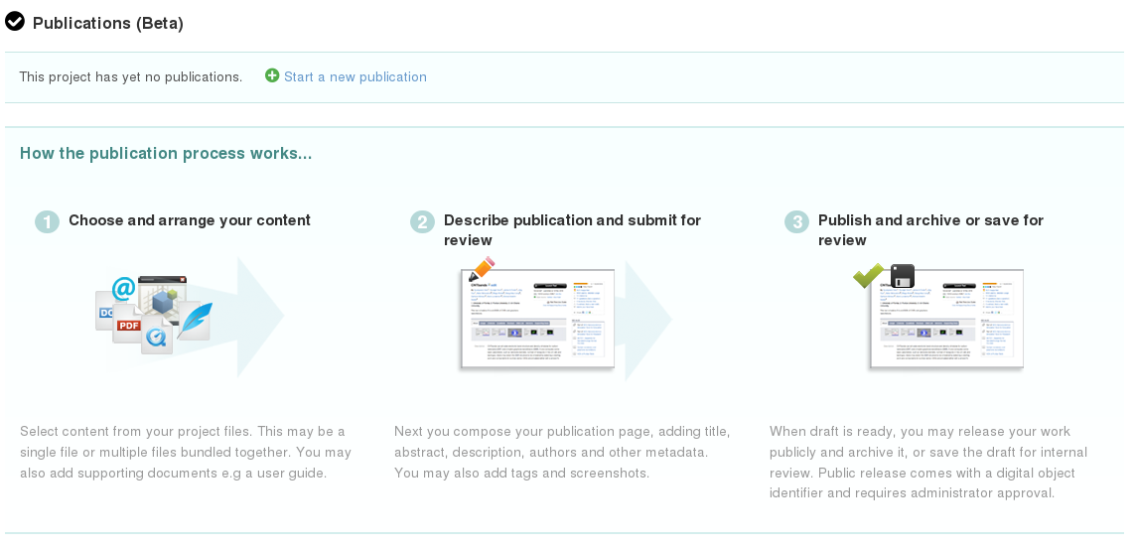
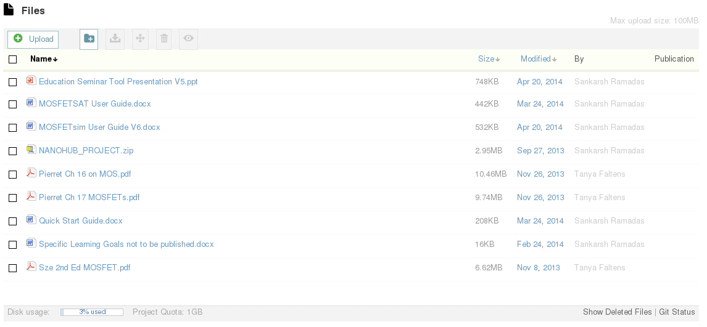
What is a hub?
Simulation Tools
Content Sharing
Collaboration
Data Management
Notes:
Our team produces a software platform, called HUBzero, that we use to put together dynamic websites, called “hubs”, to support science and research communities.
Our group manages about 20 hubs that allow users to develop and deploy simulation tools that others can run inside of their web browser, share content like lectures, notes, papers, collaborate within groups to build specialized communities, and manage and publish data like results from experiments.

Slide 3


HUBzero History
Notes:
The hub started back in 2005, when the team was responsible for one hub, nanohub.org.

Slide 4
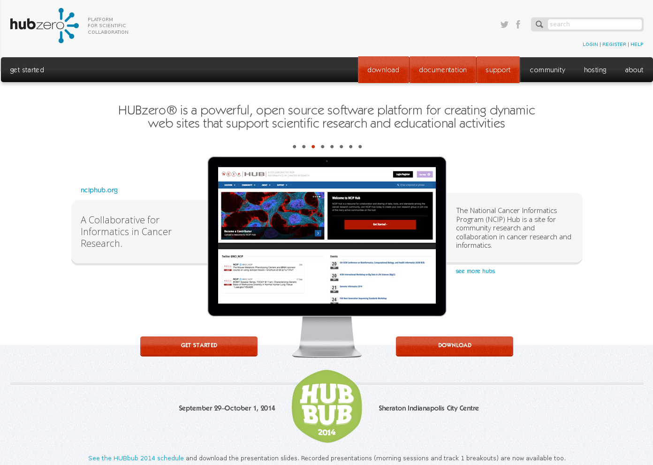


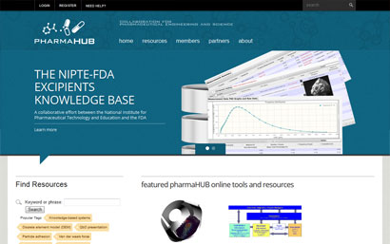
HUBzero History
Notes:
In 2007, the number of hubs in production had risen to 4

Slide 5
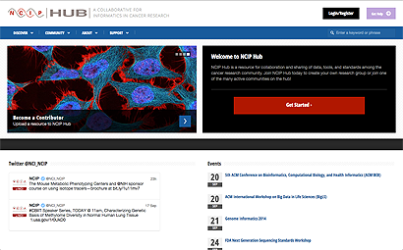

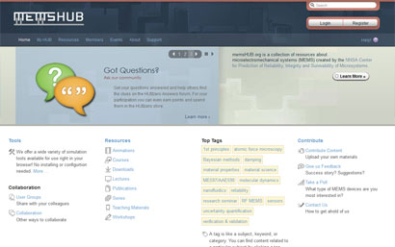
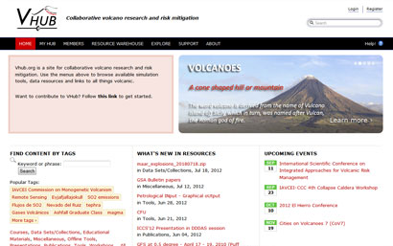
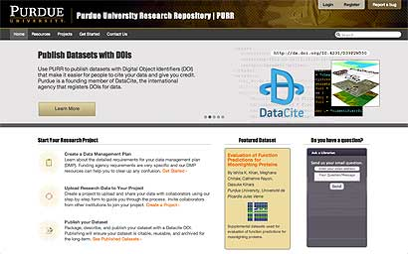
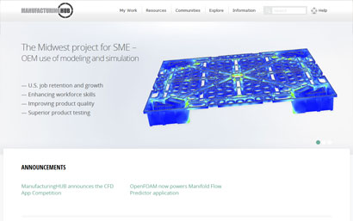
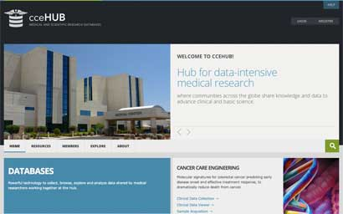

HUBzero History
Notes:
And by 2012, the team was supporting over twenty hubs. Through this expansion, the code base for building hubs was centralized so the software could be updated from a single master copy
But each hub was still its own website with its own configuration.

Slide 6

HUBzero History
Notes:
And the small differences between hubs provided opportunities for bugs to pop up.

Slide 7
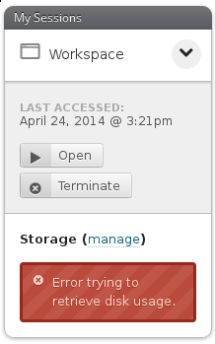
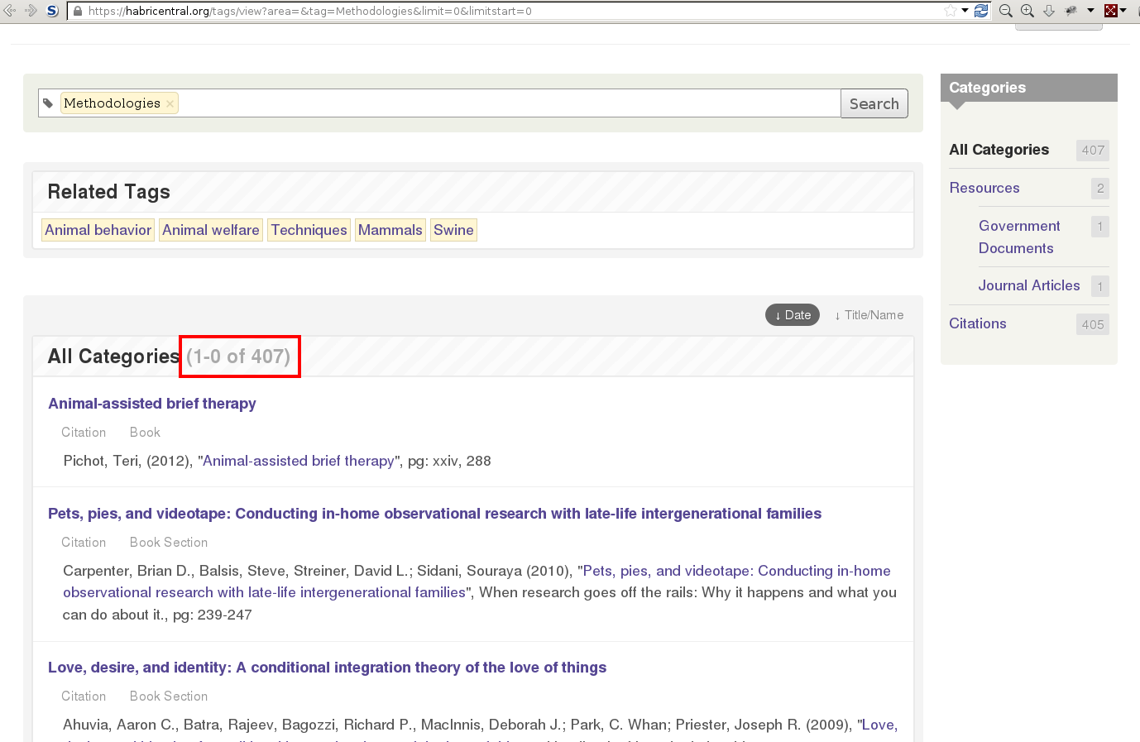
Types of Errors
Notes:
We're usually notified about problems because something on the website isn't working properly, or something looks out of place.
Sometimes these problems are just programming errors in the code, like off by one counting or simple configuration settings, that are quickly found and fixed.

Slide 8
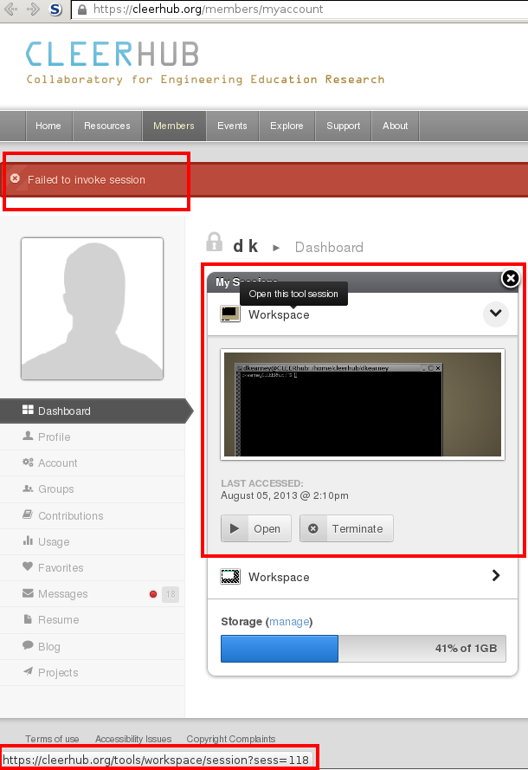
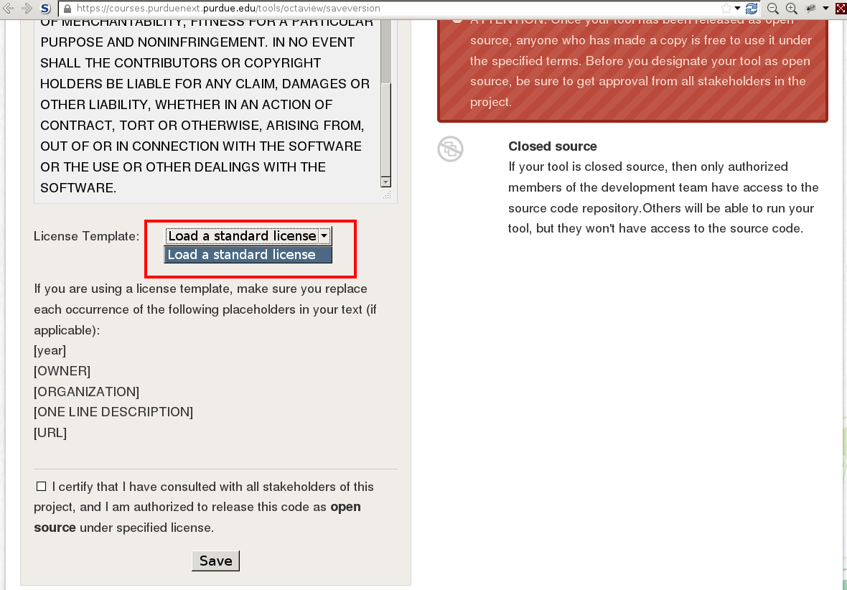
Types of Errors
Notes:
But some error are deeper in the website, requiring manual testers to run through a series of steps or repeatedly perform a tedious procedure before the bug is revealed.
Like in these two examples, where a manual tester has to make it to the last step of contributing a resource to the web site before seeing that they can't choose a license for the resource they are about to publish.
Or that after starting a simulation tool, they get a failure message, even though they can see the tool in the background.

Slide 9
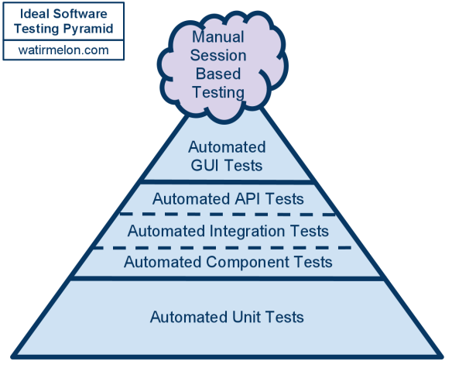
Testing on the hub
} User InterfaceTests
} Service Layer Tests
} Unit Tests
Notes:
One of the things missing from our development process is a good set of automated unit tests. But building a broad base of unit tests for software already in production doesn't happen over night and the immediate returns can be hard to see. Project timelines and lack of experience with testing can often discourage developers from participating in this phase of the software development lifecycle.
To begin to get a handle on when things break and on which hubs they are broken, I started looking at ways we could check if things were working at the user interface level. This would at least allow us to make sure the examples and procedures that we wanted our customers to use were working properly.

Slide 10
Testing on the hub
} User InterfaceTests
} Service Layer Tests
} Unit Tests
Notes:
There are a number of tools that work at the UI level to check web sites for various levels of correctness. For example IBM AppScan performs UI level security scans, and there are some web browser automation tools like Sahi Pro.
But none of the currently available tools would work out of the box because the hub is a dual environment system.

Slide 11


Testing on the hub
} User InterfaceTests
} Service Layer Tests
} Unit Tests
+
Notes:
You see, on the hub, users interact with the web site through a web browser, but they also interact with the hub's simulation tools, which run in Debian Linux based virtual containers that can also be accessed over SSH
I wanted to be able to write automation scripts for both environments, because some of the hardest things to manually check are the processes that use both environments.

Slide 12
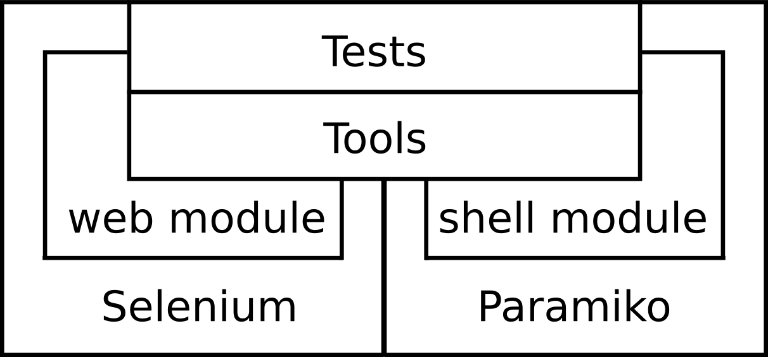


HUBcheck is...
Web Browser
Automation
Shell
Automation
+
+
+
+
paramiko
Notes:
So I developed HUBcheck, which is a Python based library built on top of Selenium WebDriver (providing web browser automation) , Paramiko (providing SSH automation), BrowserMob Proxy, ffmpeg, vnc, and a bunch of X server utilities.
HUBcheck allows developers to build automation scripts that mimic the user's experience. It tries to interact with the hub's web pages and the command line the same way a user would.
It provides ways for developers to build abstractions of hub web pages, called page objects, and it provides ways to connect to the tool session containers, that simulation tools run in, over SSH.

Slide 13
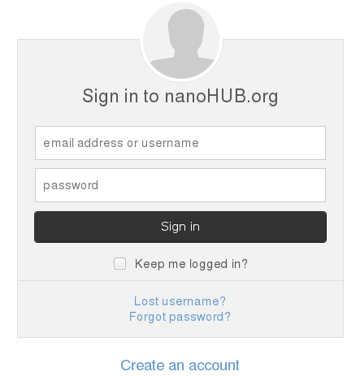
Accessing the hub website
Notes:
To demonstrate the capabilities of HUBcheck, lets first consider a web browser automation example where we want to login to a hub website.
This is the login form for one of our hubs, nanohub.org.
If we were going to manually interact with this or test the login action,

Slide 14
Accessing the hub website
username
Notes:
we would need to fill in a username...

Slide 15
Accessing the hub website
username
********
Notes:
Then type in a password...

Slide 16
Accessing the hub website
username
********
Notes:
And lastly press the submit button.

Slide 17
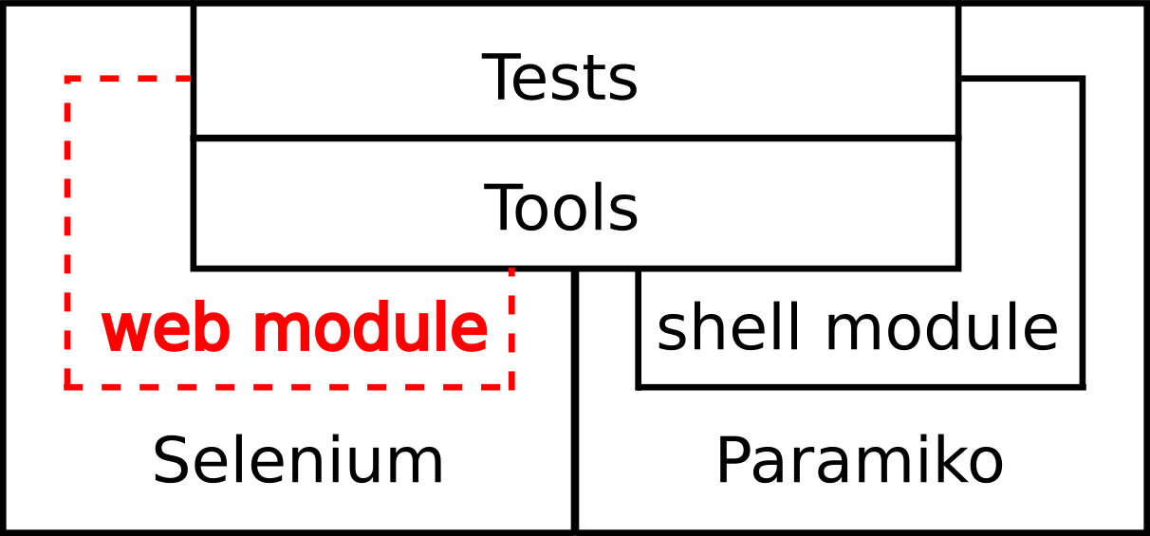
Web Automation
+
HUBcheck Page Object
class LoginPage(BasePageWidget):
def __init__(self, locator):
...
self.username = Text(self,...)
self.password = Text(self,...)
self.submit = Button(self,...)
...
def login_as(self,username,password):
self.username.value = username
self.password.value = password
self.submit.click()
Notes:
HUBcheck provides a developer with the capabilities to perform the same actions. The HUBcheck library includes a set of classes, called page objects, that are abstractions of web pages or parts of web pages found on hubs.
Here is a page object for the hub login web page.

Slide 18
Web Automation
+
HUBcheck Page Object
class LoginPage(BasePageWidget):
def __init__(self, locator):
...
self.username = Text(self,...)
self.password = Text(self,...)
self.submit = Button(self,...)
...
def login_as(self,username,password):
self.username.value = username
self.password.value = password
self.submit.click()
Notes:
In this page object, the fields in the form are represented by data members of the page object class, which also happen to be smaller page objects

Slide 19
Web Automation
+
HUBcheck Page Object
class LoginPage(BasePageWidget):
def __init__(self, locator):
...
self.username = Text(self,...)
self.password = Text(self,...)
self.submit = Button(self,...)
...
def login_as(self,username,password):
self.username.value = username
self.password.value = password
self.submit.click()
Notes:
And services of the web page are represented by methods of the page object class.
You can see that in the login_as service, we set the value of the “username” field, then set the value of the “password” field, and lastly click the submit button, just like a user would.

Slide 20
Web Automation
+
Python Script
import hubcheck
username = 'username'
password = 'password'
hc = hubcheck.Hubcheck(hostname='nanohub.org',
locators='nanohub',
browsertype='Firefox')
# setup a web browser
hc.browser.get('https://nanohub.org')
# login to the website
po = hc.catalog.load_pageobject('LoginPage')
po.goto_page()
po.login_as(username,password)
username
********
Notes:
In an automation script, we can use HUBcheck to launch a web browser, navigate to the hub login web page, and then use our LoginPage page object to perform the “login service” of filling in the form and pressing the sign in button.
The Page Object design pattern isn't new, but out of the box, no packages other than HUBcheck provides page objects for the hubzero software. Additionally, the HUBcheck page objects are not hub specific. Our team manages nearly 20 hubs and HUBcheck can configure the page objects based on the hub it is running against.
While instrumenting hub web pages, I've also developed a few patterns or best practices for building robust page objects for situations where the naive approach is inefficient.

Slide 21
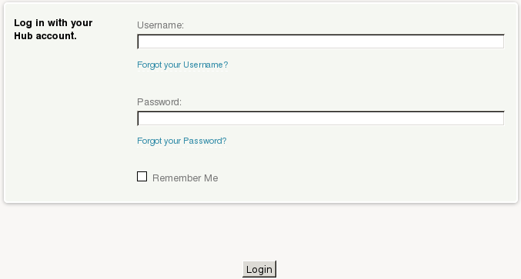
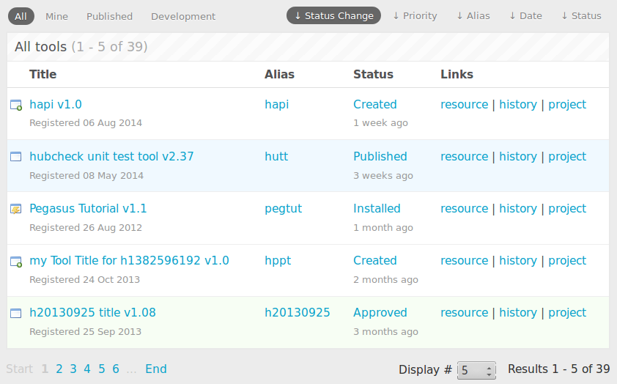
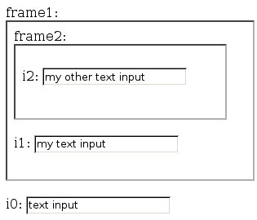
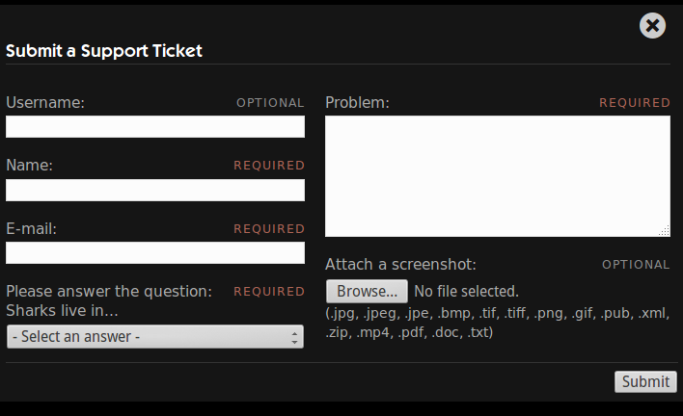
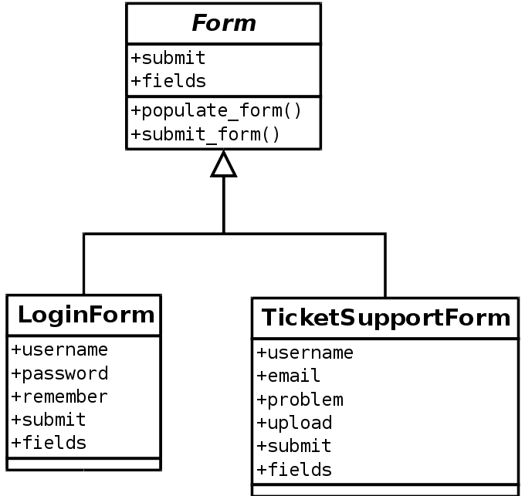
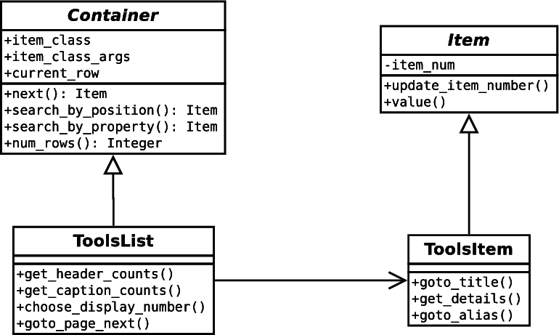
Page Object Based Design Patterns
WebForm Pattern
ItemList Pattern
IframeWrap Pattern
Frame1 Context
value()
value()
value()
Notes:
The first pattern deals building page objects for forms. We use a lot of forms on the hub, and the page objects tend to look the same. They all want the user to take some answers to questions, fill them in to fields on the web page, and press the submit or cancel button. So the WebForm pattern encourages developer to use a generic “Form” page object, and customize it with fields specific to the form being automated.

Slide 22
Page Object Based Design Patterns
WebForm Pattern
ItemList Pattern
IframeWrap Pattern
Frame1 Context
value()
value()
value()
Notes:
The second situation is dealing with lists of items on a web page. If you have a list of items on a web page, you never know how many items will be displayed. The ItemList Pattern encourages users to build a single page object to represent an item in a list, and update which item in the list that the page object points to instead of trying to build a separate class for each item in the list.

Slide 23
Page Object Based Design Patterns
WebForm Pattern
ItemList Pattern
IframeWrap Pattern
Frame1 Context
value()
value()
value()
Notes:
The last pattern is probably the most interesting because the problem could mean a tremendous amount of work, but in the end, a simple solution saves us. Its the IframeWrap Pattern.

Slide 24
How do Iframes work
Notes:
Here is an example web page with three input fields and two frames.

Slide 25
How do Iframes work
Default Context
i0 input in Default Context
<html>
<body>
<label for="frame1">frame1: </label>
<iframe id="frame1" src="inner_page.html"></iframe>
<br/><br/>
<label for="i0">i0: </label>
<input type="text" id="i0" value="text input"></input>
</body>
</html>
Notes:
The first input field, i0, is located in the default context. This is the level of the web page we generally work in when iframes are not involved.
Along with the input field i0, this web page also has an iframe, frame1.

Slide 26
How do Iframes work
Frame1 Context
i1 input in Frame1 Context
<html>
<body>
<label for="frame2">frame2: </label>
<iframe id="frame2" src="another_page.html"></iframe>
<br/><br/>
<label for="i1">i1: </label>
<input type="text" id="i1" value="my text input"></input>
</body>
</html>
Notes:
This area makes up what we refer to as the Frame1 Context. The Frame1 context has an input field i1, and another iframe, frame2.

Slide 27
How do Iframes work
i2 input in Frame2 Context
Frame2 Context
<html>
<body>
<label for="i2">i2: </label>
<input type="text" id="i2" value="my other text input"></input>
</body>
</html>
Notes:
Lastly, this area makes up the Frame2 Context. It only contains the input field i2.
The problem is, if I have a page object that represents a element that exists outside of an iframe, like the input field i0, do I need to create a new class to represent the same element that exists inside of an iframe, like i1 or i2?
Let me explain a little more...

Slide 28
Page Object for i0
class Text(BasePageWidget):
def __init__(self, locator):
…
# getter
def value(self):
e = self.find_element(self.locator)
return e.get_attribute('value')
# setter
def value(self, text):
e = self.find_element(self.locator)
e.clear()
e.send_keys(text)
def append(self, text):
e = self.find_element(self.locator)
e.send_keys(text)
Default Context
Notes:
If we wanted to build a page object for the i0 input field, that resides in the Default Context, it would look something like this.
There would probably be a getter method to retrieve the value of the input, a setter method to set the value of the input, and maybe an append method that just appended text to whatever was already in the field.
Since the i0 field resides in the default context, there is no need to do anything special, our methods will find the i0 input element in the HTML DOM, and perform actions on it.

Slide 29
Page Object for i1
class Text1Frame(BasePageWidget):
def __init__(self, locator):
…
# getter
def value(self):
…
# setter
def value(self, text):
frame = self.find_element('#frame1')
self._browser.switch_to_frame(frame)
e = self.find_element(self.locator)
e.clear()
e.send_keys(text)
self._browser.switch_to_default_content()
def append(self, text):
…
Frame1 Context
Notes:
If we wanted to build a page object for the i1 input field, we would have to do a little more work.
The page object is almost the same as the one for the i0 input field, but because i1 is located inside of the Frame1 context, we have to instruct the web browser to traverse an iframe to get to it.
So inside each of our methods we add a few lines of code to traverse the iframe, then we search for the element in the HTML DOM, perform our actions on the element, and lastly, we have to return back to the default context.

Slide 30
Page Object for i2
class Text2Frame(BasePageWidget):
def __init__(self, locator):
…
# getter
def value(self):
…
# setter
def value(self, text):
frame1 = self.find_element('#frame1')
self._browser.switch_to_frame(frame1)
frame2 = self.find_element('#frame2')
self._browser.switch_to_frame(frame2)
e = self.find_element(self.locator)
e.clear()
e.send_keys(text)
self._browser.switch_to_default_content()
def append(self, text):
…
Frame2 Context
Notes:
Building a page object for the i2 input field is similar, but since its located inside of the Frame2 context, which is located inside of the Frame1 context, we have to traverse both frames, perform our core actions of clearing the field and typing new text into it, then return to the default context.

Slide 31
IframeWrap Design Pattern
Use Decorator Pattern to wrap attributes of a page object with Enter / Exit iframe calls.
value()
value()
value()
0 Iframes
1 Iframe
2 Iframes
Notes:
So back to our question, do we really need three separate classes to represent these page objects?
If we do, it means we have a lot of work ahead of us because any time we find one of our page objects in an iframe, we have to create a new copy to handle the iframe traversal.
Well, as you might have guessed, the answer is no because we can use the IframeWrap Pattern which uses the Decorator Pattern to “decorate” or wrap the attributes of a page object with code to:
1. Enter an iframe context.
2. Call the original page object method.
3. Exit the iframe context.

Slide 32
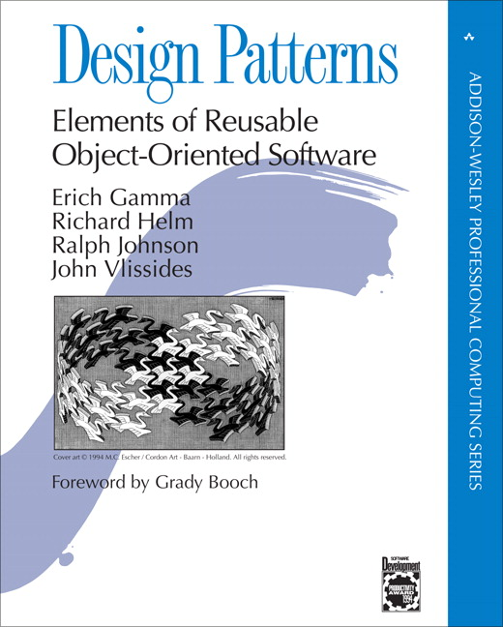
Decorator Pattern
Attach additional responsibilities to an object dynamically and transparently.
class A (object):
def f (self):
do_some_stuff()
a = A()
a
a
f
function
f
wrapper
function
Before Decoration
After Decoration
Notes:
The purpose of the decorator pattern is to extend functionality of an object without necessarily changing the interface or other objects of the class.
It does this by wrapping the original functionality of the object's attribute with code to do extra stuff.
For example, if we had an object 'a', which was an instance of class 'A', with a method 'f', we could add functionality to 'f' by first pointing a.f to our wrapper method, and then in our wrapper method, we would add the extra code to extend a.f, and call the original function object.

Slide 33
Applying the Decorator Pattern
class Text(BasePageWidget):
# setter
def value(self, text):
e = self.find_element(self.locator)
e.clear()
e.send_keys(text)
i1 = Text('#i1')
i1.value('new i1 text')
Frame1 Context
i1
i1
value
function
value
wrapper
function
Before Decoration
After Decoration
Notes:
We can apply this same idea to our Text page object.
The page object has a method named value() that performs the core actions of adjusting the underlying HTML element.
In Python, the object's value attribute points to a function object, so we can represent it like this.
We can decorate this function object to add our “enter” and “exit” iframe commands.
After decorating the function object, the value attribute will point to our wrapper function, and our wrapper function will call the original function object.

Slide 34
Using an IframeWrap'd page object
class FramedInputs(BasePageObject):
def __init__(self):
self.i0 = Text('#i0')
self.i1 = IframeWrap( Text('#i1'), ['#frame1'] )
self.i2 = IframeWrap( Text('#i2'), ['#frame2', '#frame1'] )
po = FramedInputs()
# print out the current text in the widgets
print "i0.value = %s" % (po.i0.value)
print "i1.value = %s" % (po.i1.value)
print "i2.value = %s" % (po.i2.value)
# update the text in the widgets
po.i0.value = 'i0 text'
po.i1.value = 'new i1 text'
po.i2.value = 'new i2 text too'
Notes:
In the end, we can create the objects that represent the i0, i1, and i2 text input fields by using the same Text class.
For i1, and i2, we call the IframeWrap function to decorate the object's methods to enter and exit the correct frame context.
You'll notice that when we go to use the i0, i1, and i2 objects in our automation script, their interface shows no details of frames being involved. It is hidden inside of the object.

Slide 35
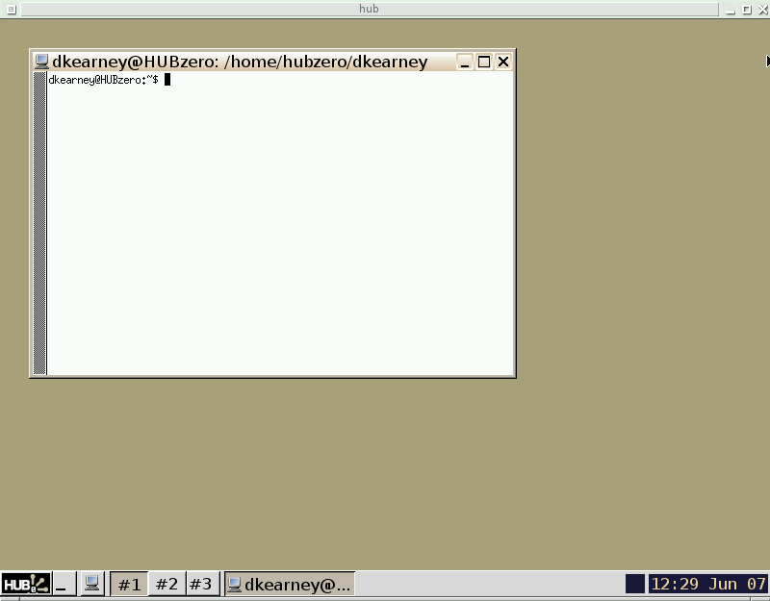

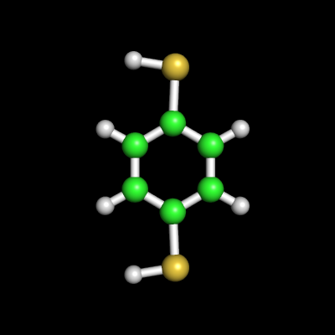
Accessing the hub shell
User's Web Browser
HUBzero Infrastructure
Web Server
Middleware
Grid
Submit
Proxy
Tool Session
Containers
Visualization
Notes:
I mentioned earlier the HUB is a dual environment system.
We've been discussing automation in the web browser environment. Let's now focus on automation in the tool session container environment, where simulation tools run.
Normally, users start simulation tools from the web browser. That request travels through the web server and to the middleware which allocates a Debian Linux based virtual container running on an execution host.
Simulation tools run in this environment, which has access to grid infrastructure and visualization servers. This is also the environment where HUB users can develop simulation tools for their research.

Slide 36
Accessing the hub shell
User's Terminal
HUBzero Infrastructure
Web Server
$ ssh username@hub session
Entering session 1234
hub $
Middleware
Grid
Submit
Proxy
Tool Session
Containers
Visualization
Notes:
The middleware provides an ssh interface to interact with tool session containers.

Slide 37
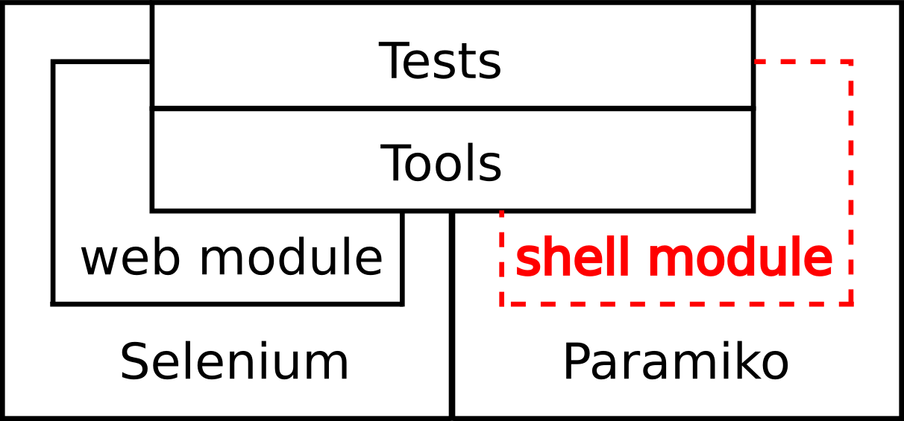
Shell Automation
+
paramiko
Python Script
HUBzero Infrastructure
Web Server
import hubcheck
cm = hubcheck.ContainerManager()
shell = cm.access(host,user,passwd)
out,status = shell.execute('echo hi')
Middleware
Grid
Submit
Proxy
Expect-like interface
for running commands
Tool Session
Containers
Visualization
Notes:
And by using the Parmaiko Python library, HUBcheck can automate access to the environment so developers can write automation scripts to interact with the containers, running commands through an Expect-like interface.

Slide 38
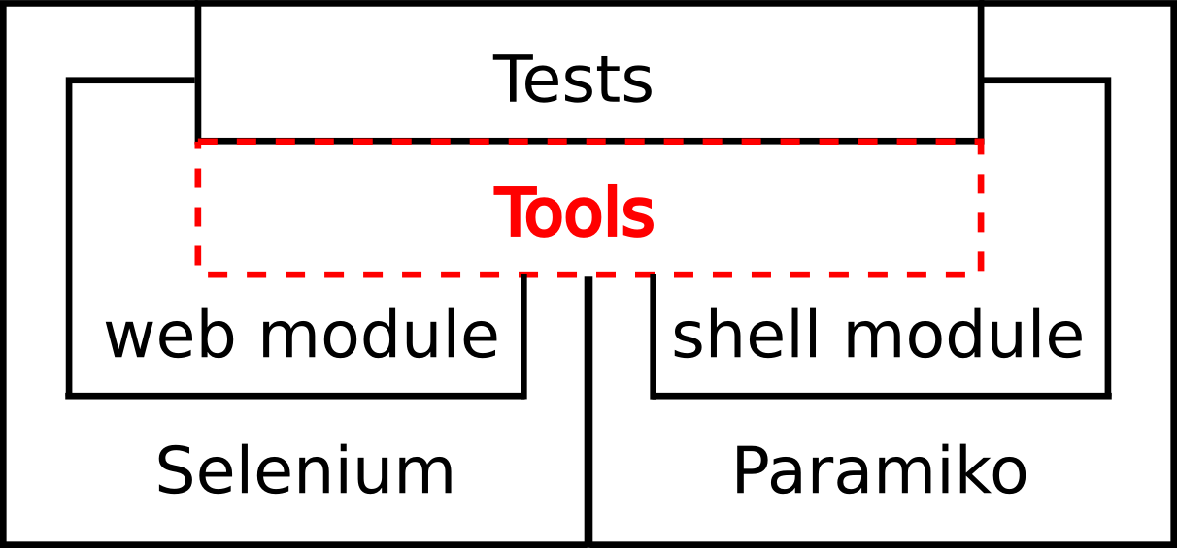

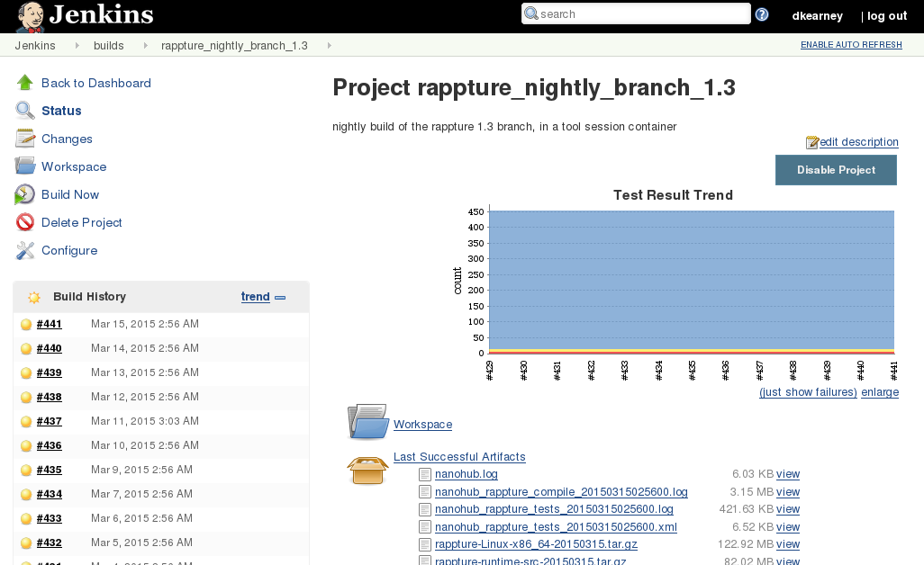
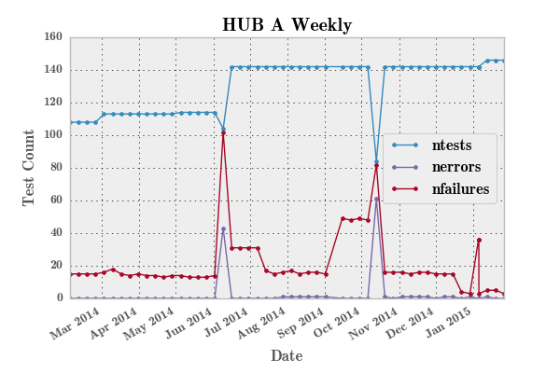
HUBcheck Tools
NANOHUB-U Course Registration
Nightly Rappture Builds
Nightly/Weekly Test Suites
Notes:
A number of tools have been built on top of HUBcheck. A few years ago, our team was using a HUBcheck based script to registering students for courses on NANOHUB-U, a part of the nanohub.org website, while a more automated solution was being developed.
Recently we started using a HUBcheck based script to perform nightly builds and tests of hubzero's Rappture Toolkit, our inhouse graphical user interface library, inside of the tool session container.
Probably the most used tool, and one of the original motivations for building the HUBcheck library was for running nightly and weekly tests on the hubs we manage. This is the job of a tool called hctestrunner.

Slide 39
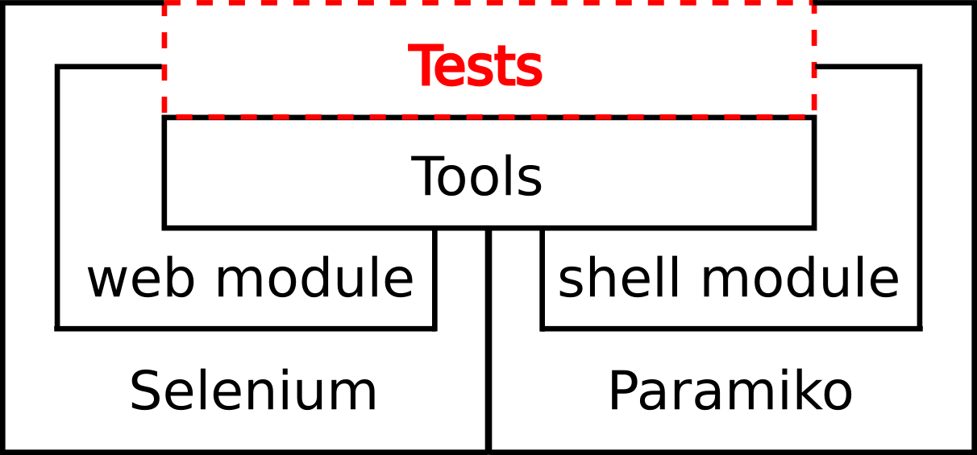
Test Runner
Nightly Test Suite
* covers access to workspace
* short jobs to make sure submit and webdav are working
Weekly Test Suite
* more in depth testing of workspace and website
* check workspace setup
* help track hub configuration problems.
Notes:
The hubcheck test runner uses both HUBcheck and PyTest, a Python testing library.
Currently, it is regularly running two test suites.
The nightly test suite covers access to the hub and the tool session containers, and is meant as a “smoke” test, to alert the HUBzero team of major failures that may happen on a daily basis.
The weekly test suite does more in depth testing of the workspace and website. This test suite helps us track a number of hub configuration problems as hubs go through their weekly upgrades.
Both test suites are heavily focused on the tool session container environment and have less tests that cover aspects of the website.

Slide 40
Promoting Healthier Hubs
Notes:
From Feb 2014 to Feb 2015, our team spent a lot of time upgrading hubs, and we were able to use HUBcheck to track problems that needed to be fixed on hub.
Over the observation period, there were two types of upgrades occurring. The first type of upgrade was hub website code being upgraded to the 1.2.2 code base and 1.3.0 code base. The second type of upgrade had to do with tool session containers having their operating systems and configurations upgraded from Debian Linux 5 and 6 to Debian Linux 7.
Using HUBcheck our group was able to monitor the health of hubs, get a better understanding of when failures occurred on our systems, and react to broken features.
Our hubs usually fall into one of three health categories:
Turbulent, Upgraded, or New

Slide 41
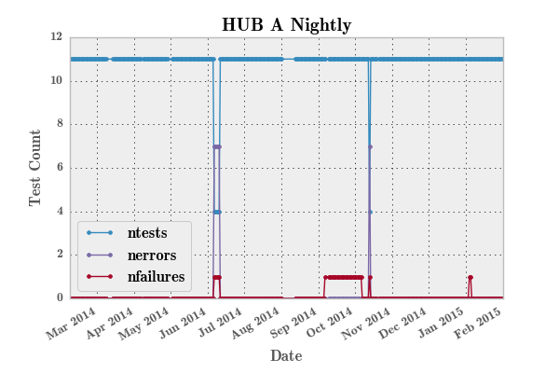
Turbulent Hubs
Characterized by:
High test failure count
Long spikes of elevated test failures
Notes:
Turbulent hubs are usually older hubs that have been through a number of hubzero software upgrades, when the upgrade process wasn't as structured as it is today. The health signature of these hubs is characterized by a fairly constant number of failures, sometime elevating for periods of time as bugs go unnoticed or fixes take a long time to be deployed.
These are plots showing the number of tests run and number of failures noted for a particularly turbulent hub that we manage. A number of things contributed to the extended spikes in test failures including a slow upgrade process and miscommunication among team members.
Most of our hubs dont fall into the Turbulent category, and you can even see that near the end of the observation period, this hub's health signature changes for the better. Over time this hub will begin to look more like an Upgraded hub.

Slide 42
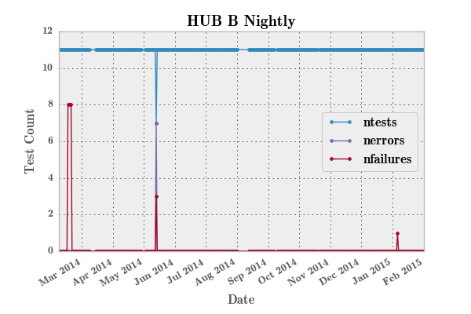
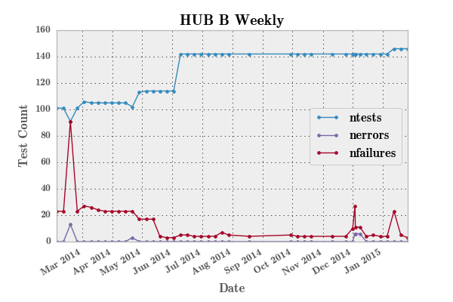
Upgraded Hubs
Characterized by:
Low test failure rate
Small spikes in failures that are quickly resolved
Notes:
The health signature of Upgraded hubs show very few failures occurring every week, and even fewer extended spikes in failures. You can see from the beginning of the graph, this hub's failure rate resembles that of the last hub we saw. In fact, this hub was launched at about the same time as the last hub, and just prior to the observation period would have probably been categorized as Turbulent due to its vintage website code and tool session container setup. But today it falls in the Upgraded category.
Through website code and tool session container upgrades the HUBzero team was able to reduce the number of failures between February and July of 2014. Additionally, when new problems arose after a software upgrade in December 2014, the team was able to quickly notice and fix the problems.

Slide 43
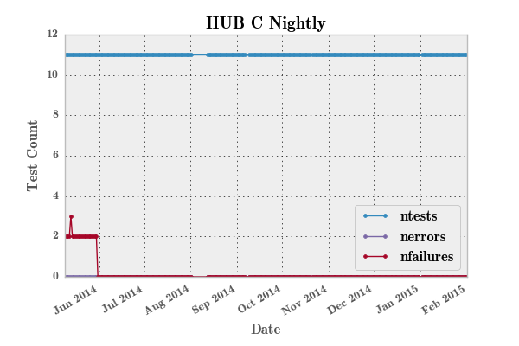
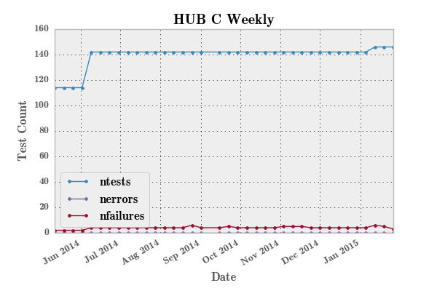
New Hubs
Characterized by:
Few test failures
Generally boring uneventful
Notes:
New hubs have the best, and most boring, health signature. Test failures are low, usually consisting of known bugs within the core hubzero software.
We strive for all of our hubs to have this type of experience.

Slide 44
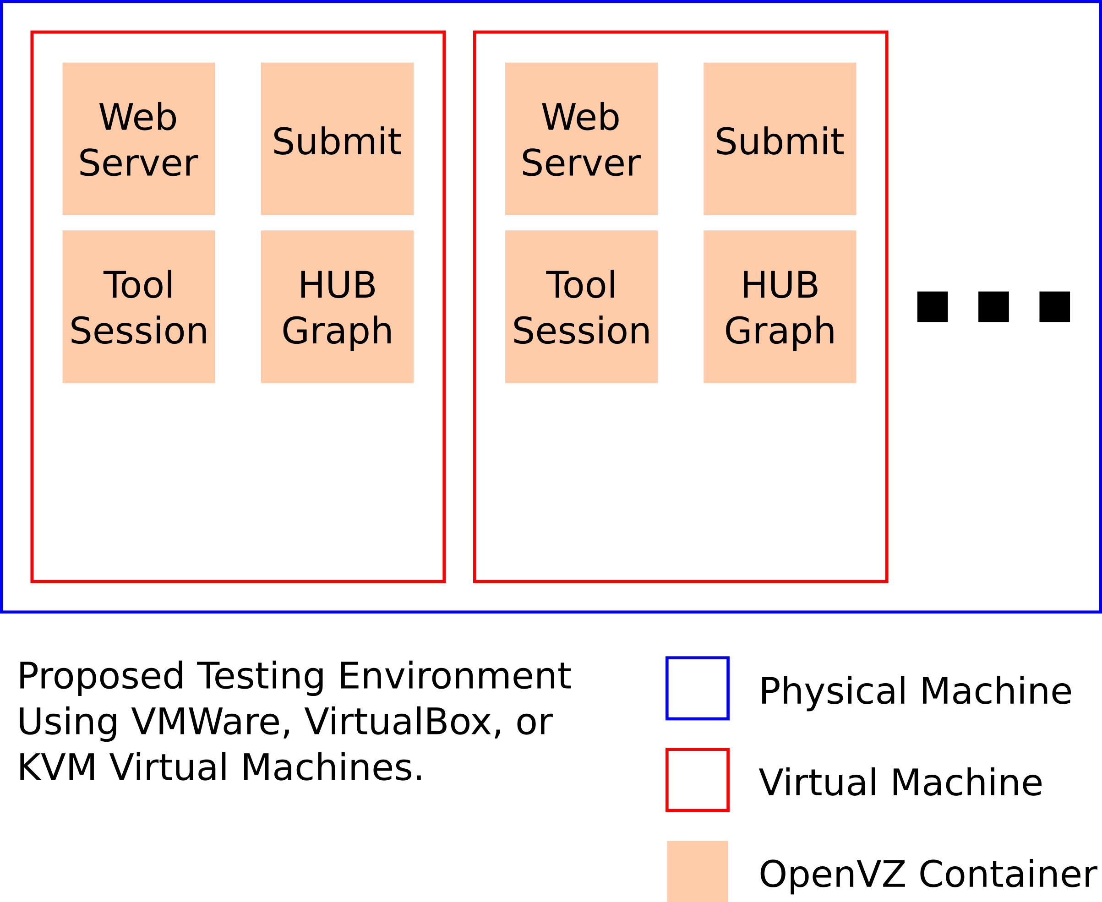
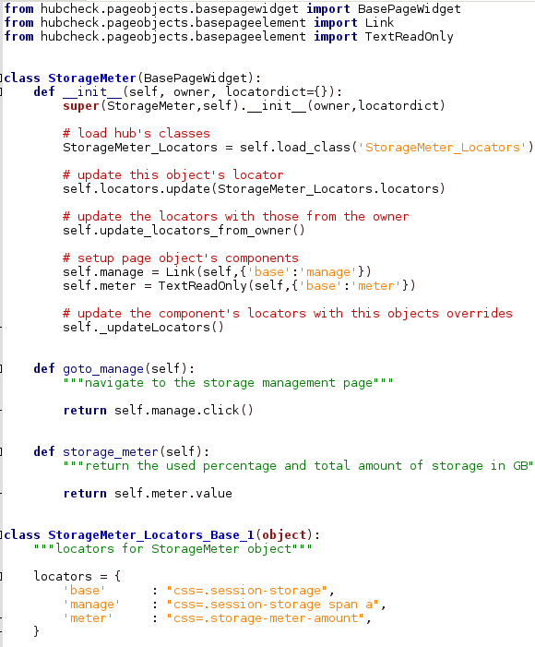
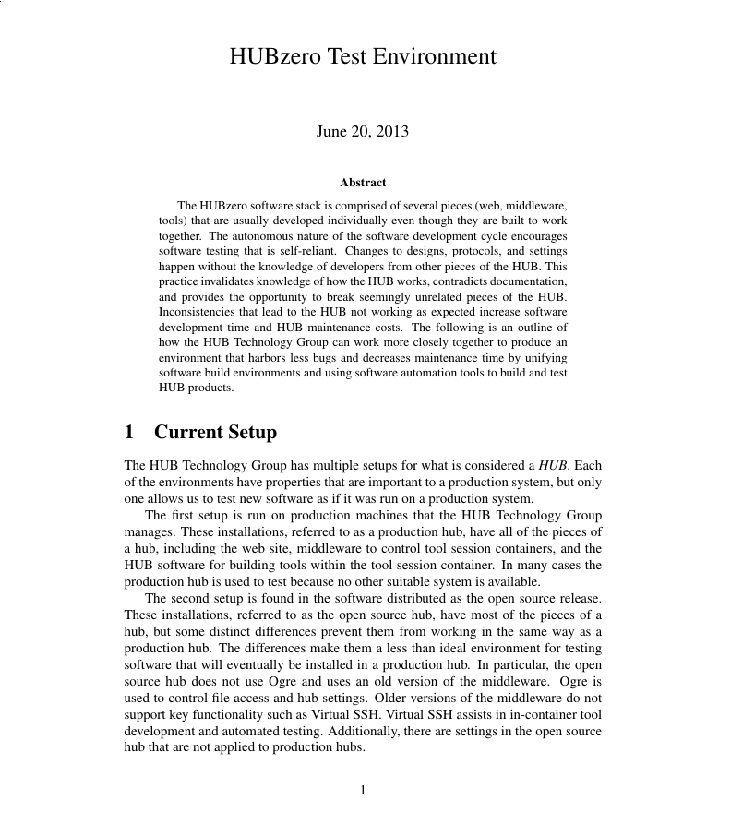

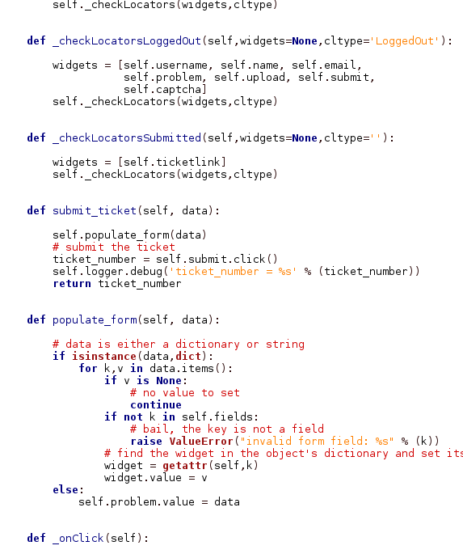

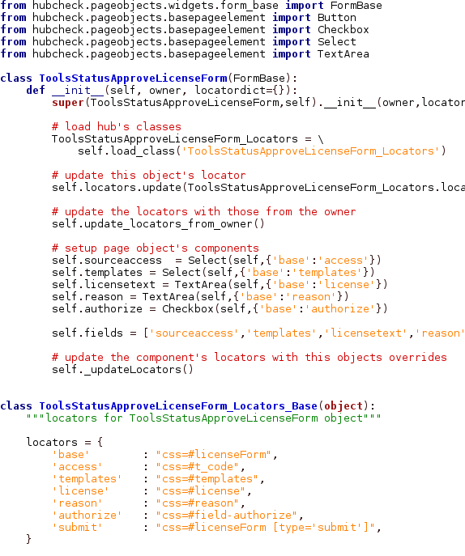
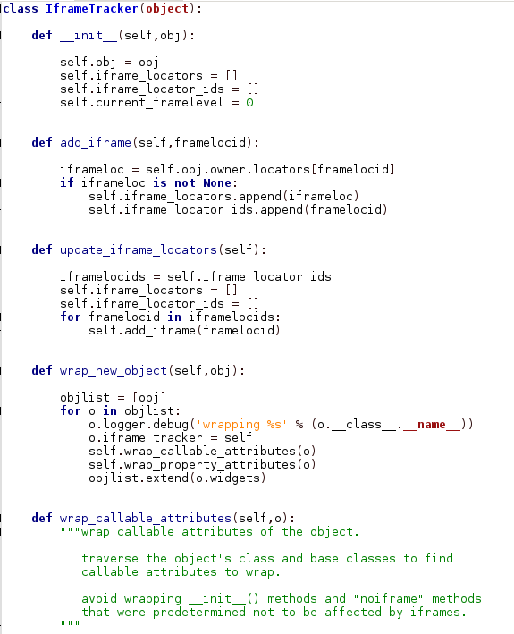
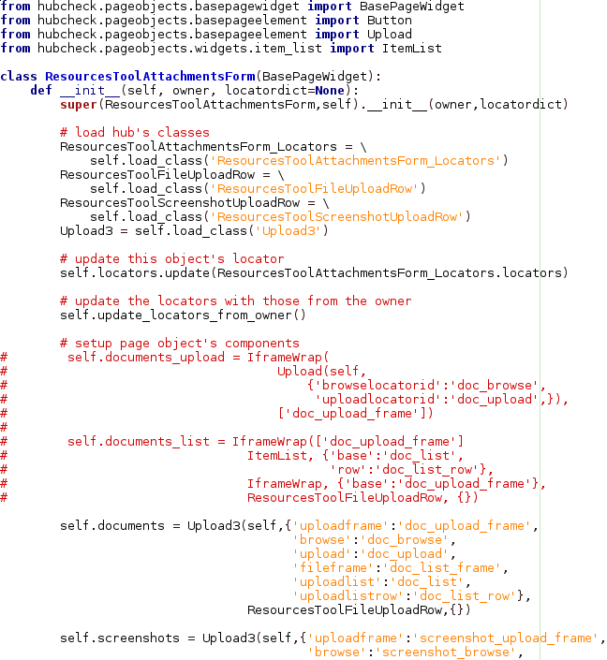

Future Work
Library Improvements
Test Environments
Evangelization
Page Objects
Debian
Packaging
Notes:
While hubcheck library development has slowed over the last few months, there is still work to be done.
First, we need to continue to build more page objects to cover the web interface.
Need to put together a Debian package for easier installation of the software.
And we need to release the open source code in a hubzero repository connected to GitHub so others can use it.

Slide 45
Future Work
Library Improvements
Test Environments
Evangelization
Page Objects
Debian
Packaging
Notes:
HUBcheck is a small piece to a larger solution that embeds testing into our development process.
A few years back, I wrote a white paper describing the type of environment our team should be using for testing. It would allow us to quickly bring up a “golden copy” of a hub that matched what we run in production, where we could add a new feature, and run a test suite to see if things break.

Slide 46
Future Work
Library Improvements
Test Environments
Evangelization
Page Objects
Debian
Packaging
Notes:
Lastly, I need to evangelize the use of HUBcheck and other testing software.
I want to encourage developers to start writing tests for the software they build. It doesn't need to be user interface tests. Preferably they would write many more unit tests.

Slide 47
Special Thanks

Slide 48
Image Credits
1. Debian - https://twitter.com/debian
2. HUBzero github image - https://github.com/hubzero
3. GitHub logo – https://github.com/logos
4. Ideal Automated Testing Pyramid - http://watirmelon.com/2012/01/31/introducing-the-software-testing-ice-cream-cone/
5. Software Testing Icecream Antipattern - http://watirmelon.com/2012/01/31/introducing-the-software-testing-ice-cream-cone/
6. Firefox logo - https://www.mozilla.org/en-US/firefox/desktop/
7. Selenium logo - http://docs.seleniumhq.org/projects/webdriver/
8. Paramiko logo - http://www.lag.net/paramiko/legacy.html

Slide 50
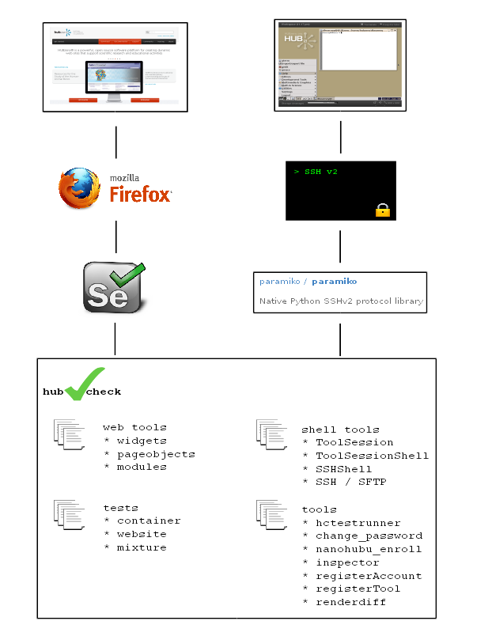

Slide 52
Page Object Based Design Patterns
WebForm Pattern
ItemList Pattern
IframeWrap Pattern
Frame1 Context
value()
value()
value()

Slide 53
Wrap attributes with iframe calls
class IframeTracker(object):
...
def wrap_callable_attributes(self,o):
for attr, item in o.__class__.__dict__.items():
if callable(item):
item = getattr(o,attr)
setattr(o,attr,self.wrap_attribute(item))
def wrap_attribute(self,item):
def wrapper(*args, **kwargs):
...
switched = self._switch_to_iframe_context(final_framelevel)
result = item(*args, **kwargs)
self._switch_to_iframe_context(initial_framelevel)
return result
return wrapper
frame = self.find_element('#frame1')
self._browser.switch_to_frame(frame)
e = self.find_element(self.locator)
e.clear()
e.send_keys(text)
self._browser.switch_to_default_content()
Notes:
The wrap_attribute() method wraps the callable attributes with calls to enter an iframe context, and exit an iframe context. The method returns a reference to the new wrapper function.
For the i1 input, you can already see the similarity between what we used to have to do manually, and what the IframeWrap pattern provides.

